Slide 1

The Nextgen kickstand
DBM215 - Prototyping Tools and Practices
(Prof. Devansh Saini)
Assignment 5.3: Final Project Presentation
Daniel Koman

Slide 2
Agenda
Project Overview
Engineering Design Process
3D Model and Design Considerations
Manufacturing Method
Prototype Images (if available)
Patent Filing Prospects
Conference and Expo Submissions

Slide 3
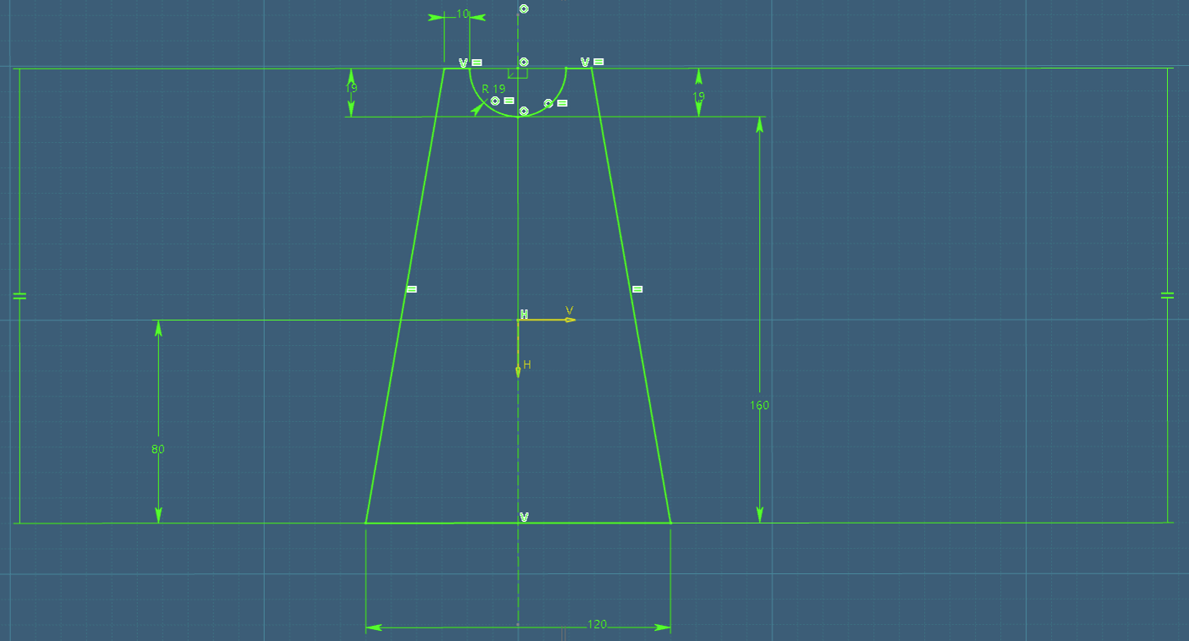
Overview of project
The NextGen Kickstand:
A revolutionary, lightweight, and portable bicycle kickstand designed for convenience and enhanced cycling performance.

Slide 4
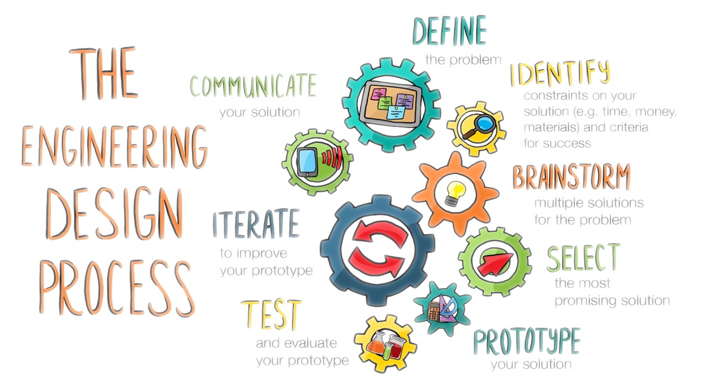
Engineering Design Process
Following the Engineering Design Process to realize project from start to finish.

Slide 5
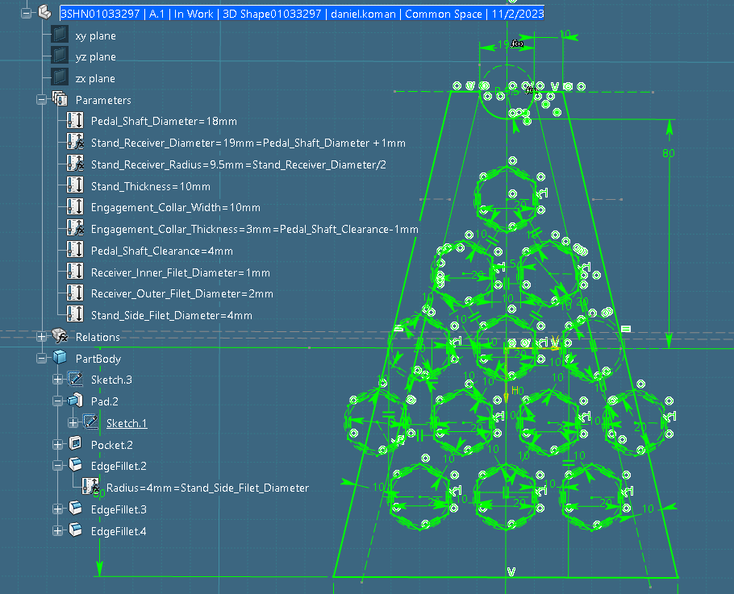
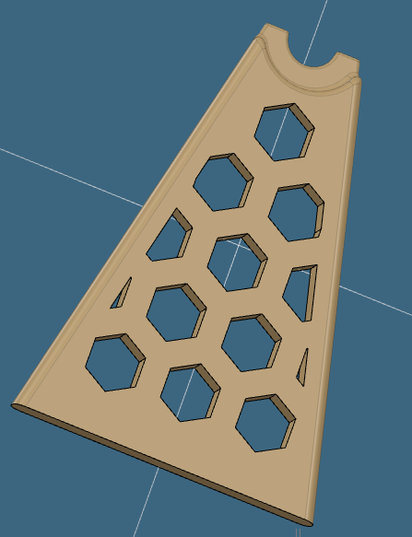
3D Model
Utilizing CATIA for detailed 3D modeling, focusing on ergonomics, safety, and human factors in the design process.
{
Fully Parameterized Model

Slide 6
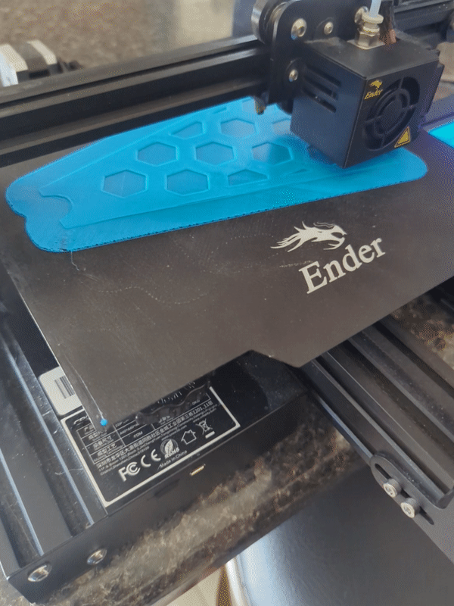
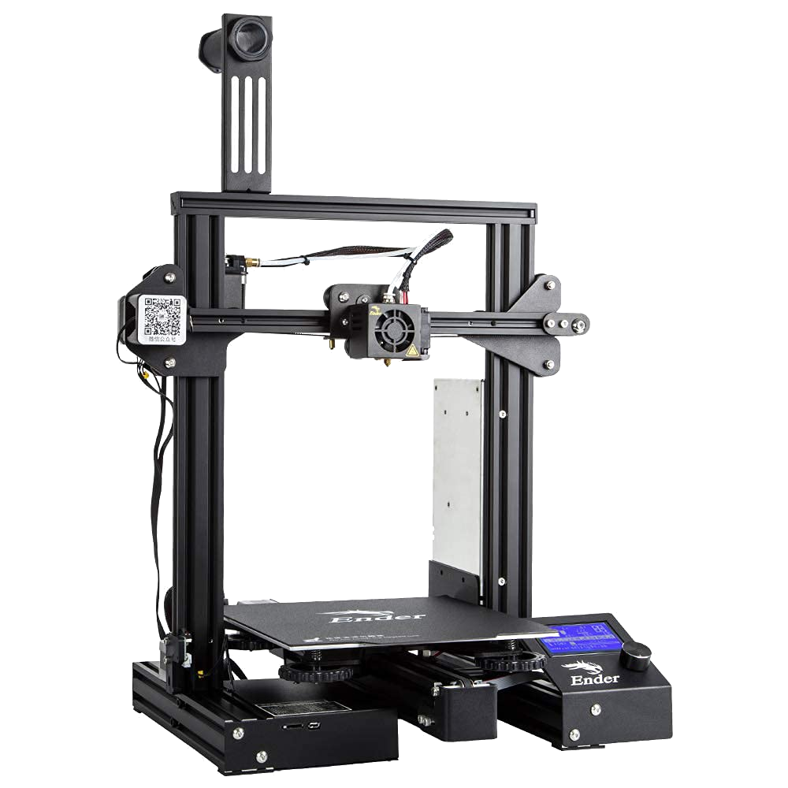
Manufacturing Method
Prototype created using a Crealty Ender 3 Pro printer, employing advanced slicing software for precision.

Slide 7
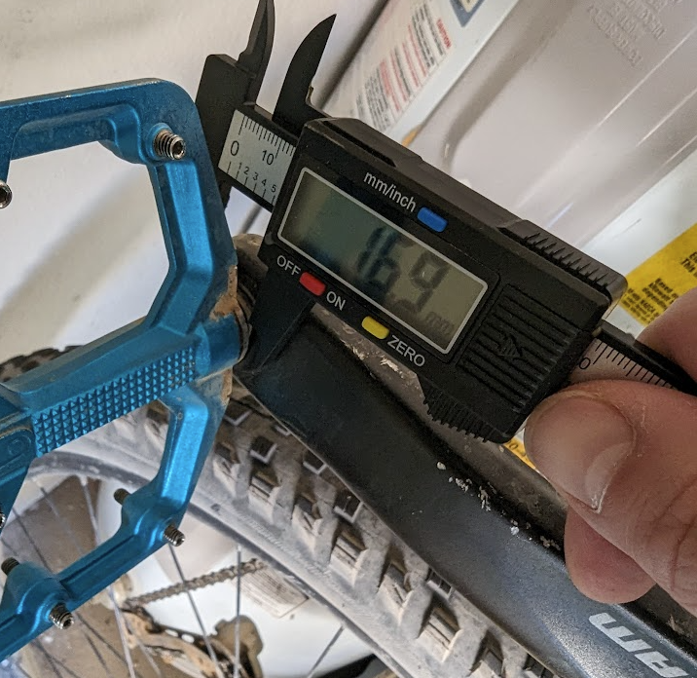
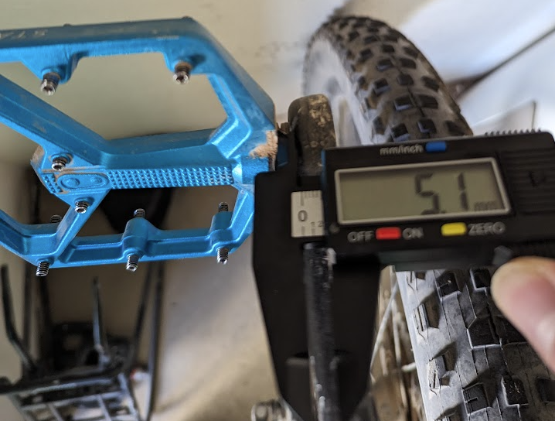
Prototype design stage 1
Measuring length-magnitude parameters, and taking notes prior to initial 2D sketches in CAD

Slide 8
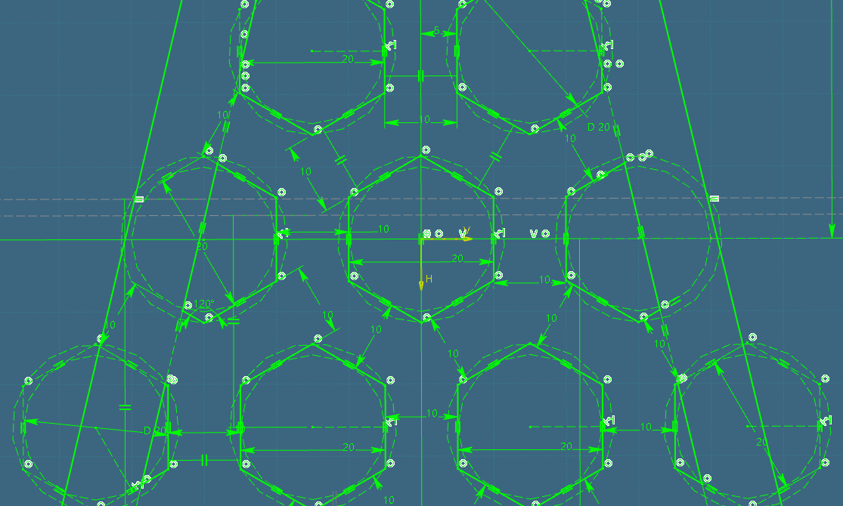
Prototype design stage 2
Initial sketching and constraint-definitions

Slide 9
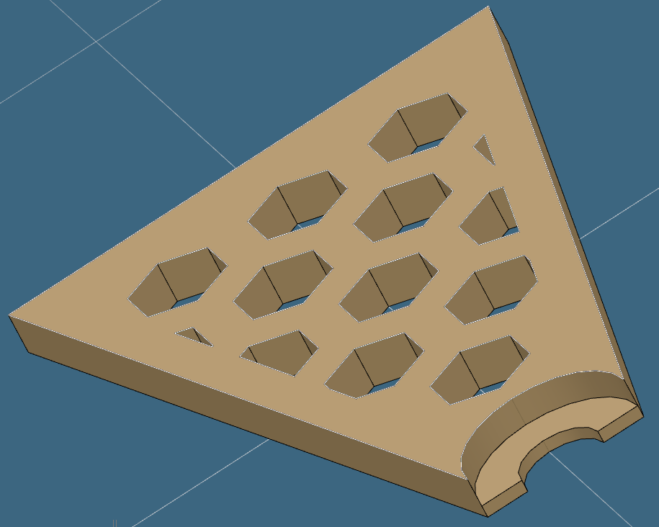
Prototype design stage 3
Extruding the 2D sketch onto the Z-axis

Slide 10
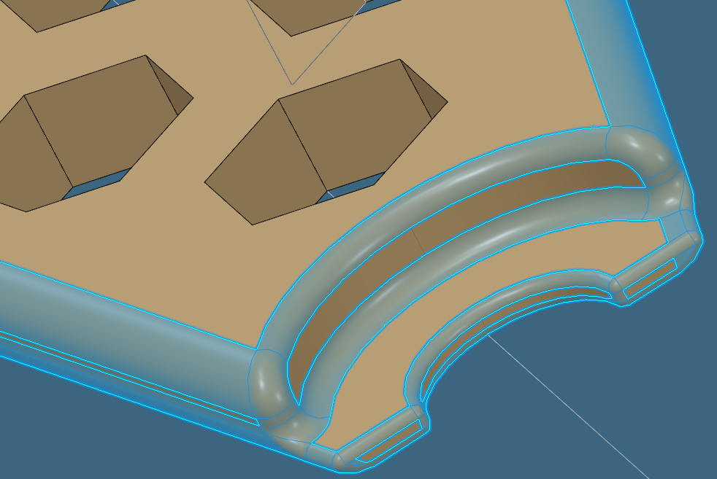
Prototype design stage 4
Adding edge fillets and refining the model

Slide 11
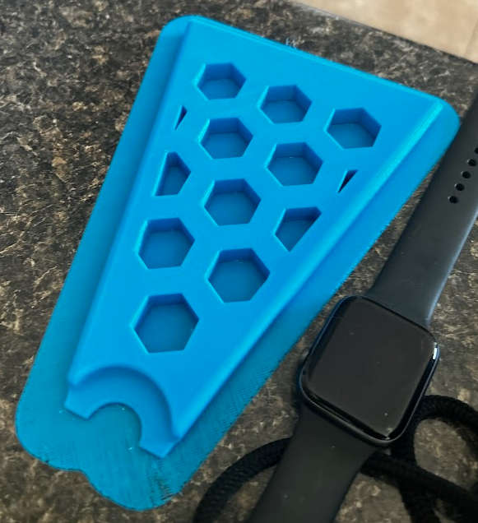
Prototype photos
Here is an actual photo of the NextGen Kickstand prototype just after printing, showcasing its practicality and design efficiency.

Slide 12
Possible Patent Filing
The innovative design and functionality of the NextGen Kickstand position it as a prime candidate for patent filing. Unique features such as its lightweight structure, portability, and universal compatibility with different bike types, and enhanced stability and support differentiate it in the market. The patent process will protect the intellectual property, prevent imitations, and solidify its place as a pioneering product in the cycling accessory industry. I'm currently exploring the feasibility of patenting its unique design elements and utility features, aiming to secure its market potential and establish a strong brand identity in the cycling world.

Slide 13
Potential Conference/Expo Submissions
The NextGen Kickstand is not only a product but a showcase of cutting-edge design and engineering. It may be pertinent to exhibit its potential at various conferences and expos, such as the international conference on mechanical and aerospace engineering, the global innovation and technology expo, and the annual cycling world expo. These platforms provide an opportunity to present our innovative design to industry experts, potential investors, and fellow enthusiasts. They also serve as a forum to receive feedback, network with professionals, and gain insights into the latest trends and advancements in the field. If my goal is to position the NextGen Kickstand as a hallmark of innovation in cycling accessories, this is the path I'd traverse.

Slide 14
Conclusion
In conclusion, the NextGen Kickstand project has been a journey of exploration, innovation, and learning. It exemplifies the application of advanced engineering design principles, 3D modeling, and practical manufacturing techniques. This project not only represents a significant advancement in cycling convenience but also highlights the importance of user-centered design in product development. The skills and knowledge acquired through this process have been invaluable, and the potential impact of this product in the cycling community is immense. As I look forward to potential patent filings and showcasing my work at prestigious conferences, I remain committed to pushing the boundaries of innovation in cycling accessories.

Slide 15
THANK YOU
Daniel Koman
555-555-5555
dankoman@uat.edu

